Slide 1
Deepfake Detection in Online Social Network (OSN)
Name : Tarunikka Suresh
ID : 2022A7PS0199U

Slide 2
PROBLEM STATEMENT
Deepfakes threaten digital trust, enabling misinformation, identity theft, and fraud.
Most detection models focus on content-level artifacts (pixels, textures, faces) but fail when videos are compressed or re-encoded.
Goal: Build a robust deepfake detection pipeline using two architectures — Vision Transformer (ViT) and XceptionNet — and compare their accuracy, AUC, and interpretability (Grad-CAM).
INPUT VIDEO OR IMAGE
Frame Extraction
Model (ViT/Xception)
Prediction
Grad-CAM Explanation

Slide 3

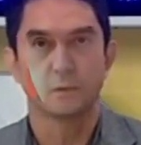
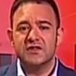
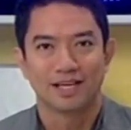
DATASET DESCRIPTION
(FaceForensics++)
Publicly available dataset containing real and manipulated facial videos.
Total size: ~Total videos: ≈ 5,000 (1,000 real + 4,000 fake)
Extracted frames: ≈ 100,000 (20 per video)
Used subset: ≈ 8,000–10,000 balanced face images
Split: 70% training, 20% validation, 10% testing
Preprocessing: Face detection via dlib, resizing (299×299 / 224×224), normalization
Category | Type | No. of Videos | Description
original_sequences/youtube/c23/videos | Real | ~1,000 | Genuine unaltered source videos
Deepfakes | Fake | ~1,000 | Autoencoder-based face swaps
Face2Face | Fake | ~1,000 | Expression reenactment
FaceSwap | Fake | ~1,000 | Identity replacement
NeuralTextures | Fake | ~1,000 | Rendered synthetic textures
Fake
Real

Slide 4
Model Architecture
XceptionNet: CNN with depthwise separable convolutions (pretrained on ImageNet).
Vision Transformer (ViT): Divides image into patches and learns relationships via self-attention.
Trained using Adam optimizer, learning rate = 1e-4, BCEWithLogitsLoss, 20 epochs, mixed precision.

Slide 5
Model Comparison
Model | Accuracy | AUC | F1-Score
XceptionNet | 0.98 | 0.999 | 0.98
ViT | 0.875 | 0.96 | 0.87

Slide 6
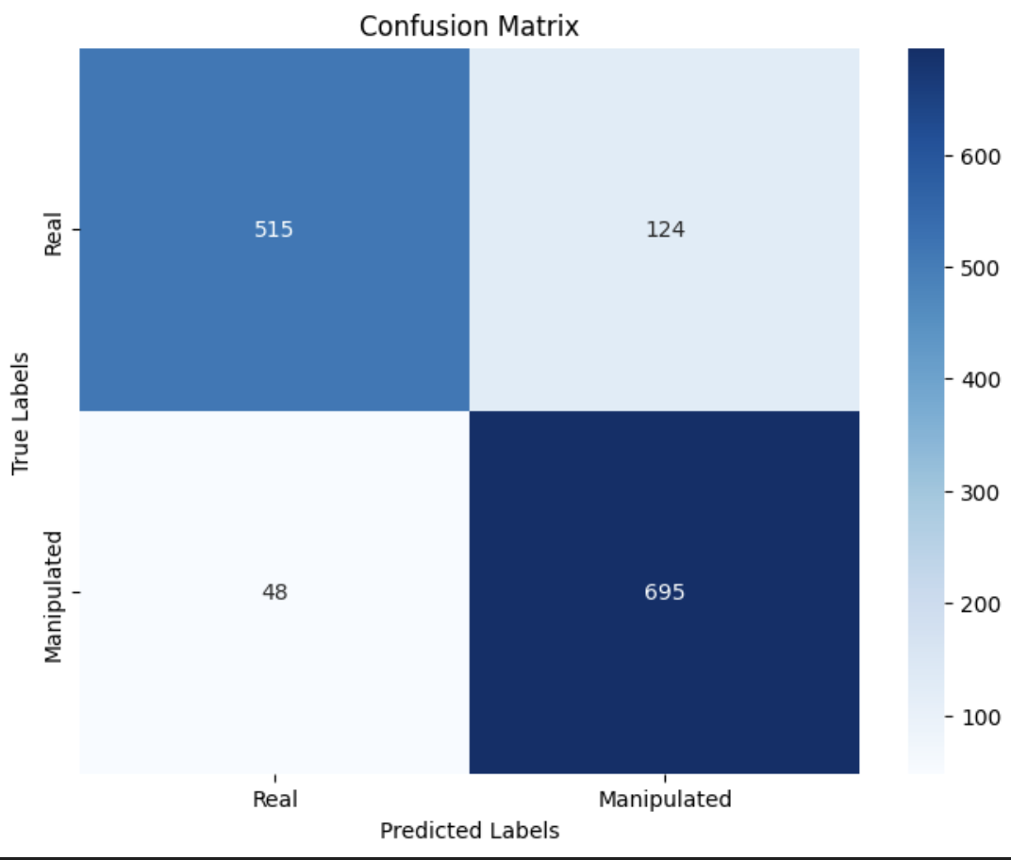
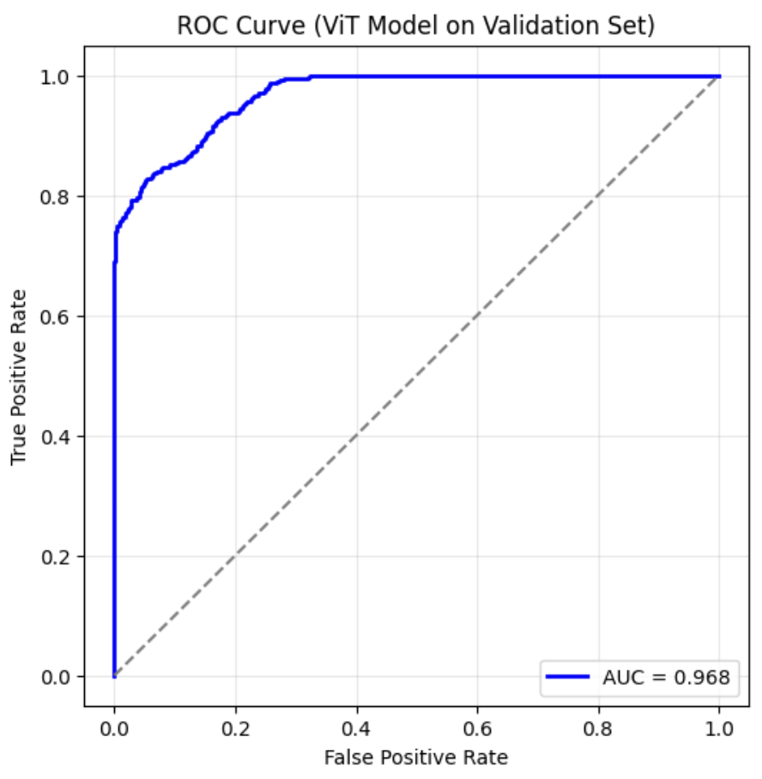
Vision Transformers

Slide 7
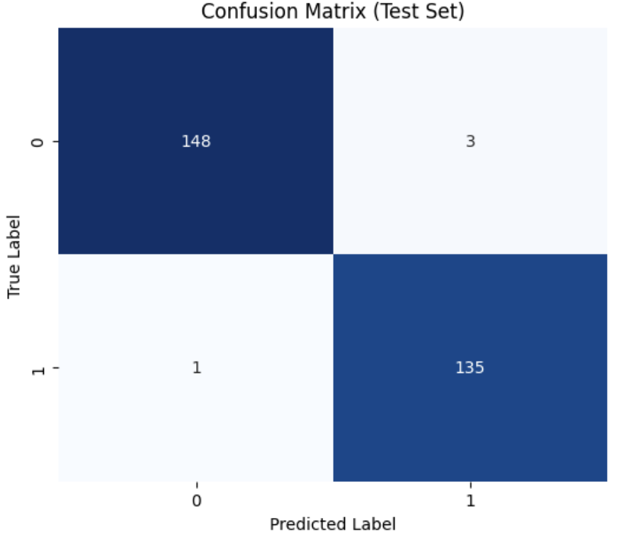
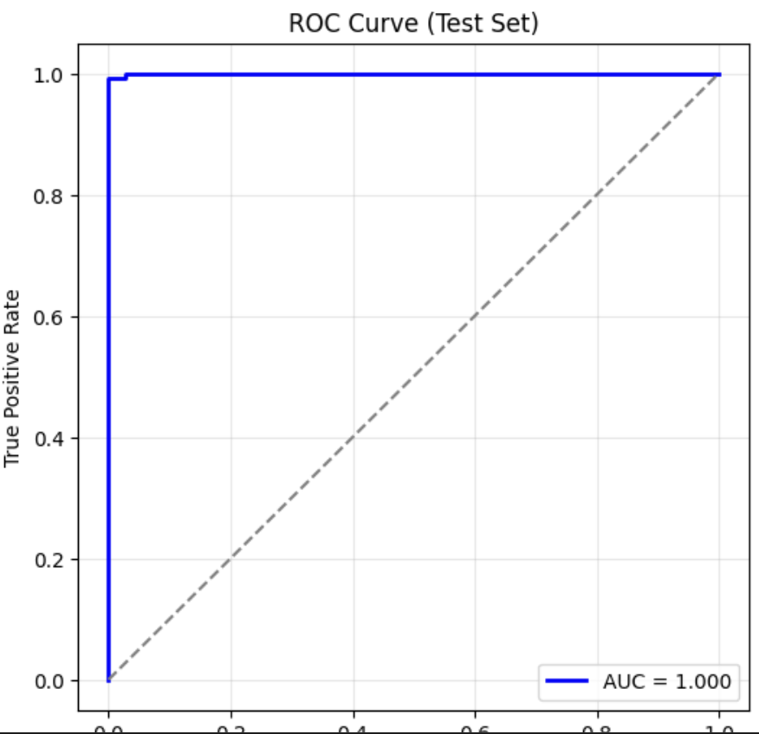
XceptionNet

Slide 8
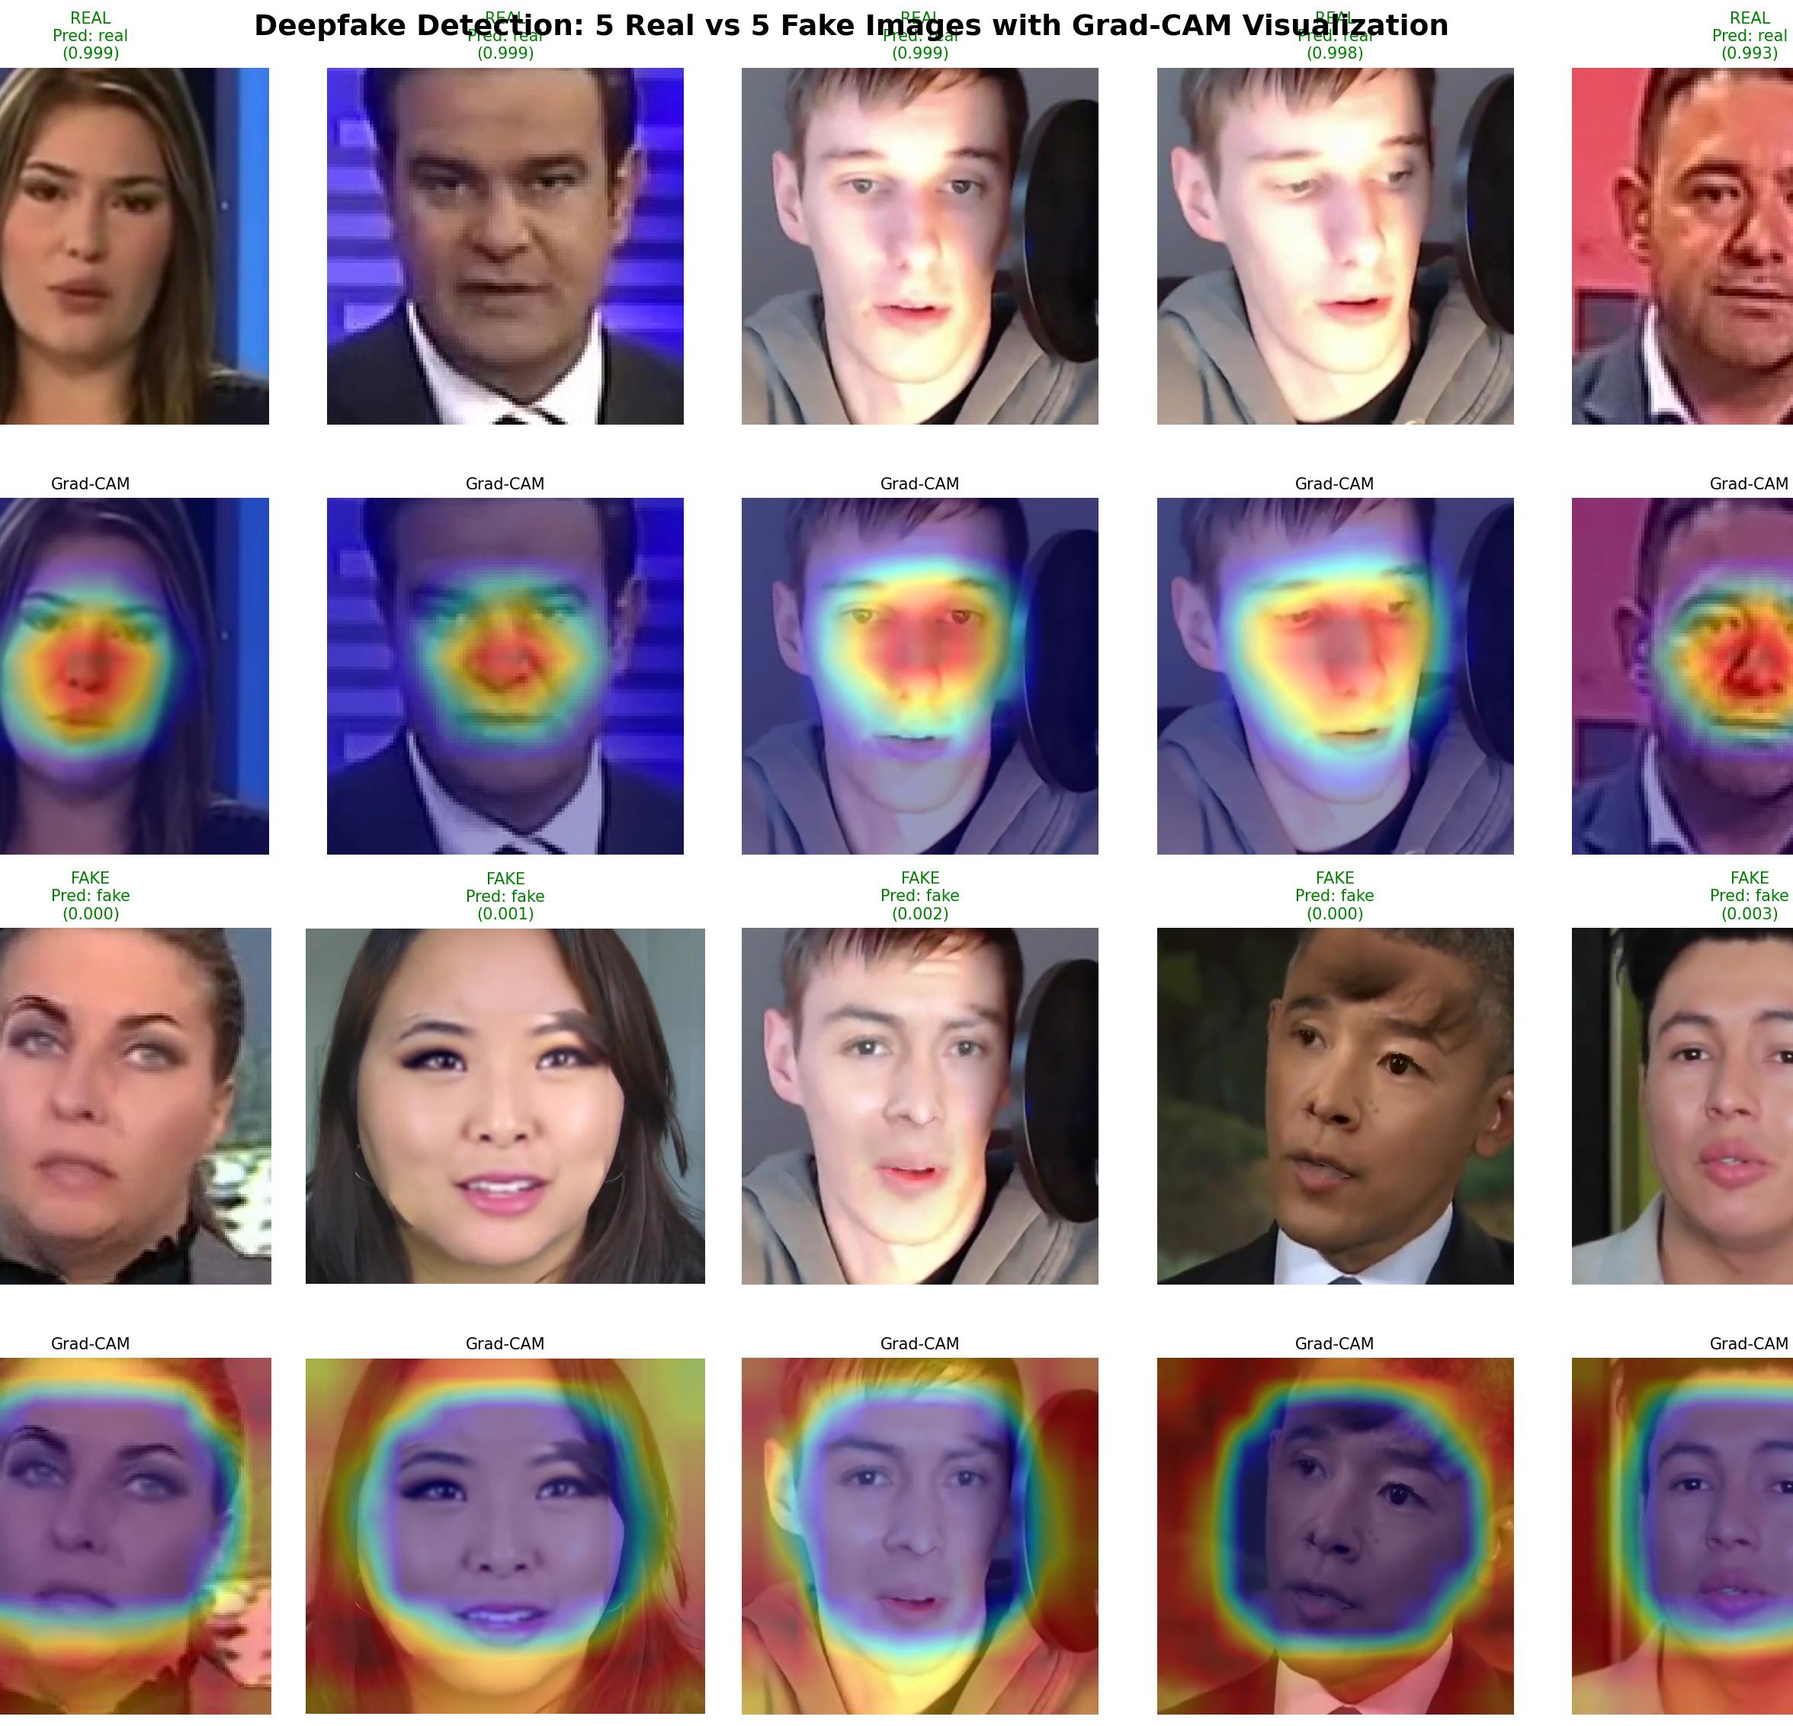
Explainability with Grad-CAM
“Heatmaps show attention areas. XceptionNet focuses on facial boundaries and lighting inconsistencies — typical indicators of manipulation.”

Slide 9
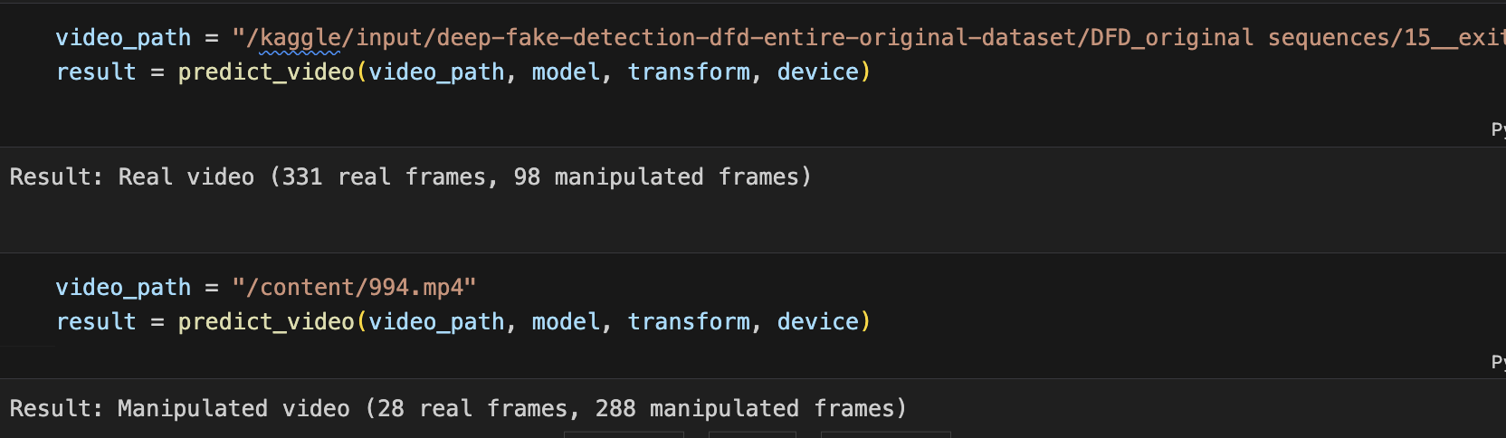
Video Inference
ViT extended to frame-wise video inference pipeline.
Detects manipulation and outputs annotated video with labels (“DEEPFAKE” / “REAL”).
Displays mean confidence score and per-frame probabilities.

Slide 10
FUTURE WORK
GAN-based Adversarial Training – generate challenging fakes (StyleGAN, Diffusion)
GAN Discriminator Reuse – use pretrained discriminators for detection
Multimodal Fusion – integrate audio, text, visual cues
Graph Neural Networks (GNNs) – model deepfake propagation on social platforms

Slide 11
Research Gap & Novel Contributions
Aspect | Existing Research | Our Contribution
Focus Area | Mostly content-level detection using CNNs, RNNs, or ViTs | Integrates content + context (video features + OSN diffusion graphs)
Dataset Generalization | Models overfit to benchmarks like DFDC / FaceForensics++ | Trained on balanced, multi-manipulation FaceForensics++ subset
Interpretability | Limited explainability | Added Grad-CAM heatmaps for model transparency
Video-Level Detection | Often restricted to image frames | Developed frame-wise video inference module
Adversarial Robustness | Not resilient to diffusion- or GAN-based manipulations | Propose GAN-based adversarial retraining
Social Context Missing | No use of repost/propagation data | Plan GNN modeling of diffusion graphs for OSN context
Evaluation | Accuracy & loss only | Full metrics (Accuracy, F1, AUC, ROC, Confusion Matrix)

Slide 12
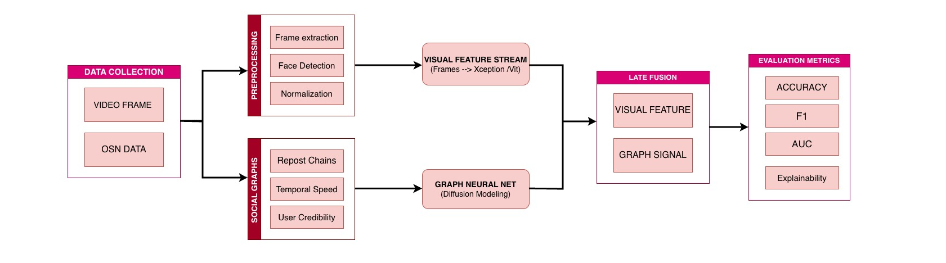
FLOWCHART

